Slide 1
Quicksort
Grant Celley, Tianyi Lin, Collin Enders

Slide 2
1. What is it?
It is a comparison-based algorithm, meaning that it can sort items of any type for which a "less-than" relation is defined.

Slide 3
2. How does it work?
Quicksort uses the divide-and-conquer technique to sort a list.
It first partitions the list into two sub-lists
Then quicksorts each sub-list
Finally, it combines the sub-lists into one list

Slide 4
2. How does it work?
1st : pick a pivot value. It can be any value in the list, but we pick the middle elements, hoping it divides the list into two sub-lists with similar size.
2nd: put elements smaller than the pivot in the left part of the array, and elements greater than the pivot in the right part of the array. Values equal to the pivot can stay on either sides.
3rd: apply quicksort algorithm recursively to the left and the right parts until they are in order.

Slide 5
2. How does it work?
Its sorting procedure happens in its partition.
1. swap the pivot with the first element of the list, initializes smallIndex to the first element
2. Start from the second element, if it is smaller than the pivot
Increment smallIndex
Swap the current element with the array element pointed to by smallIndex3
3. swap the first element (pivot) with the array element pointed to by smallIndex

Slide 6
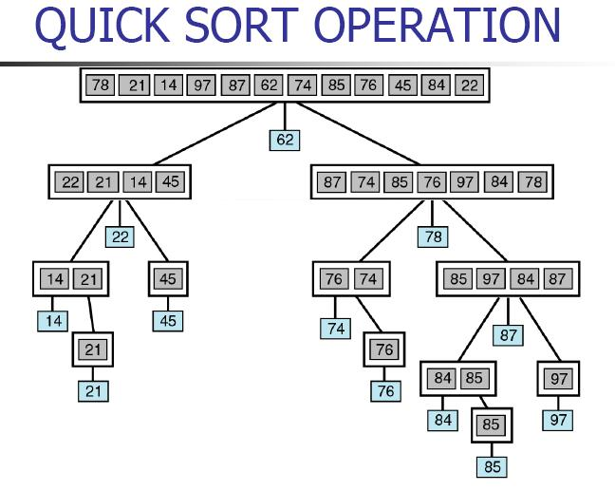

Slide 7
3. The big O notation
Average case: O( n log₂ n)
Assume n =2­­^{m}, and each call to the function recQuickSort will produce two recursive calls and it will divide the list into two sub-lists of equal size.
In order to reach a list of size 1, we need to make m nested calls, and this gives us O(m) operations.
In each nested calls, the number of comparisons will be the sum of each sub-list’s size minus 1, which is O(n).
So the maximum number of comparisons made by quicksort is O(nm). Given n=2^{m}, we can get m=log₂n. As the result, the maximum number of comparisons is O(n log₂ n).

Slide 8
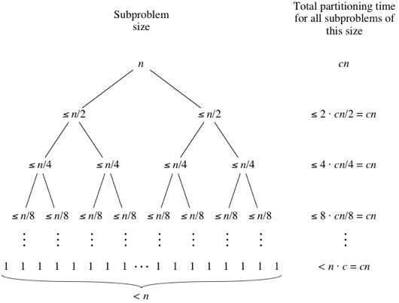

Slide 9
3. The big O notation
Worst case: O(n²).
A bad choice of pivot value will split the array into one element on one side, and the entire rest of the array on the other.
And if this happens at every iteration, it will take n iterations to split it down into pieces of one element apiece. so you get n operations, each with a complexity of O(n), which results in a O(n * n) overall.

Slide 10
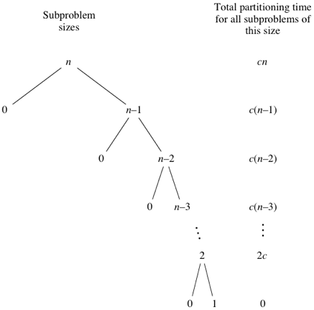
3.1 Worst case

Slide 11
4. Is it a stable sort?
No, because in Quicksort, the sequence of "equal" elements before sorting and after sorting might change.
This is because the swapping in Quicksort does not occur only with adjacent elements.

Slide 12
Thank you for your time

